Slide 1
NBT 1, 2, 3
OA 8
Monday

Slide 2
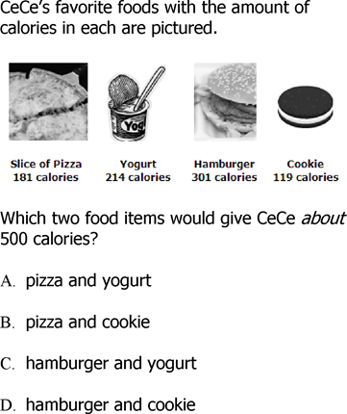
NBT 1

Slide 3
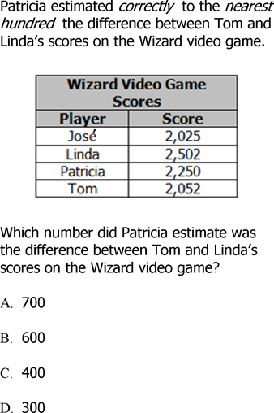
NBT 1

Slide 4
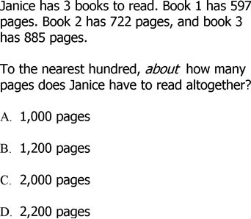
NBT 1

Slide 5
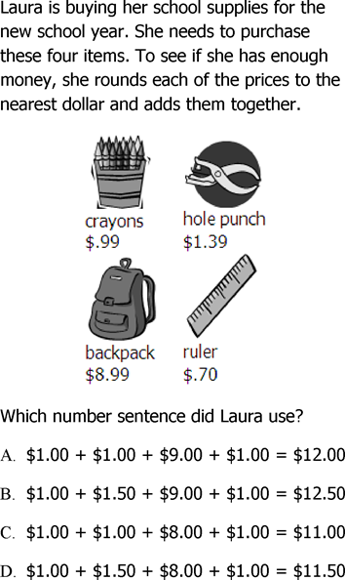
NBT 1

Slide 6
NBT 1
Antonio is saving money to buy a skateboard. The skateboard costs $82. Antonio has saved $32. Which estimate is closest to the amount Antonio still needs in order to buy the skateboard?
A. | $30
B. | $50
C. | $80
D. | $110

Slide 7
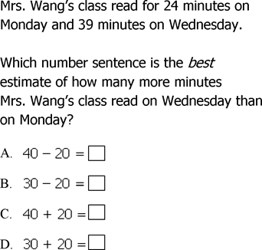
NBT 1

Slide 8
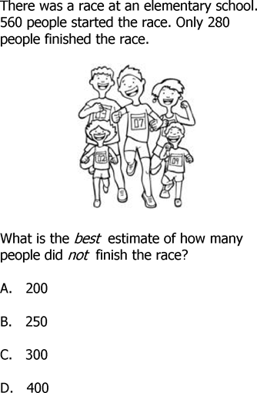
NBT 1

Slide 9
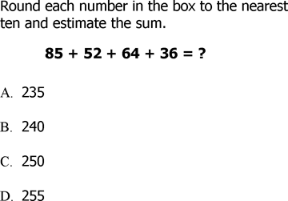
NBT 1

Slide 10
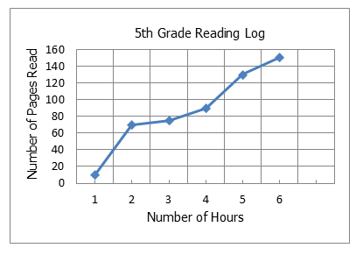
NBT 1
Look at the graph of the 5th grade reading log.
About how many more pages did they read in hour 6 than hour 5?
A. | 40 pages
B. | 30 pages
C. | 20 pages
D. | 10 pages

Slide 11
NBT 1
Sharon was playing her favorite video game. She played three games and scored 319, 292, and 274. Which shows the best way to estimate Sharon's total score for three games?
A. | 400 + 300 + 300 = 1,000
B. | 300 + 300 + 300 = 900
C. | 300 + 300 + 200 = 800
D. | 300 + 200 + 200 = 700

Slide 12
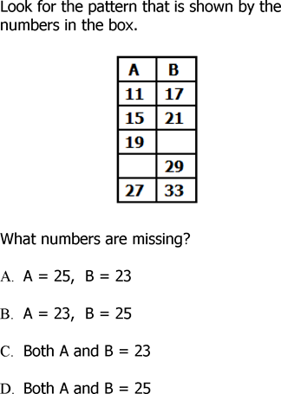
NBT 2

Slide 13
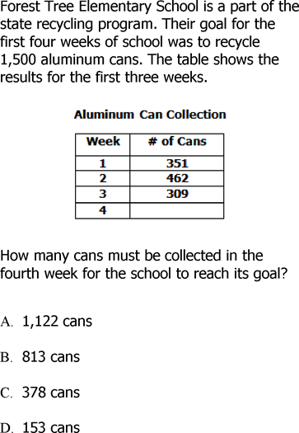
NBT 2

Slide 14
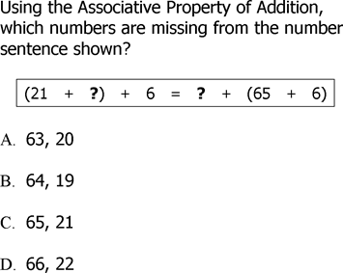
NBT 2

Slide 15
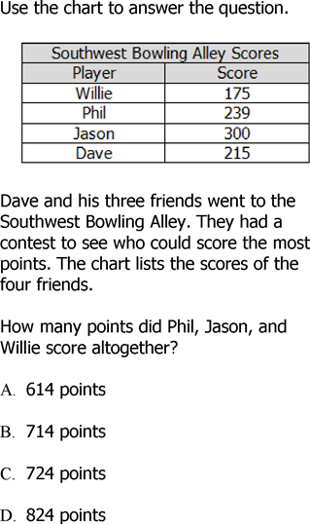
NBT 2

Slide 16
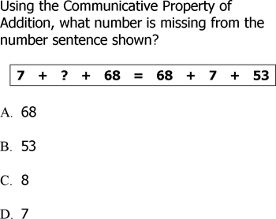
NBT 2

Slide 17
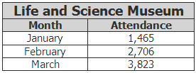
NBT 2
The Life and Science Museum attendance was greater in February and March as compared to January. The attendance for January, February, and March is shown in this table.
How many more people attended the museum in March than in January?
A. | 1,117
B. | 1,241
C. | 2,358
D. | 5,288

Slide 18
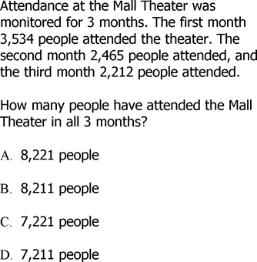
NBT 2

Slide 19
The Eastway Elementary School Chorus performed at the mall last week. The number of chorus members who are 3rd and 4th graders is shown in the table.
NBT 2
If there are 107 total 3rd and 4th graders in the school chorus, which method is best used to find the number of 3rd graders in the school chorus?
A. | Add 48 and 59
B. | Add 107 and 59
C. | Subtract 48 from 107
D. | Subtract 59 from 107

Slide 20
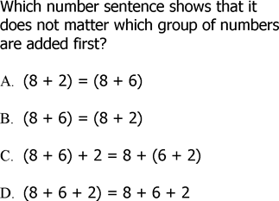
NBT 2

Slide 21
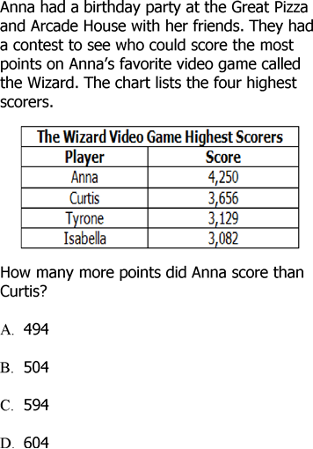
NBT 2

Slide 22
Cassie spent $22 buying makeup. She bought eye shadow for $4 and mascara for $6. She also bought 3 lipsticks. What was the cost of 1 lipstick?
A. | $8
B. | $6
C. | $4
D. | $2
NBT 3

Slide 23
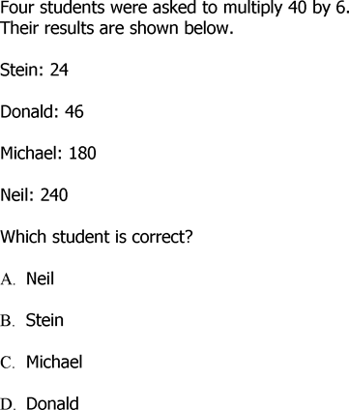
NBT 3

Slide 24
NBT 3
John spent $16 buying first aid supplies. He bought gauze pads for $5 and tape for $3. He also bought 4 boxes of bandages. What was the cost of 1 box of bandages?
A. | $5
B. | $4
C. | $2
D. | $1

Slide 25
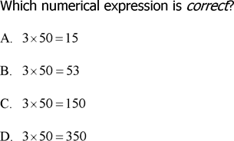
NBT 3

Slide 26
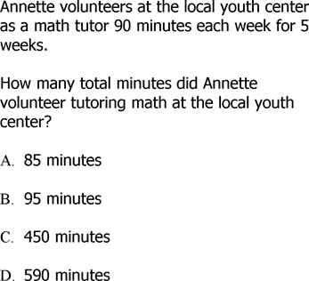
NBT 3

Slide 27
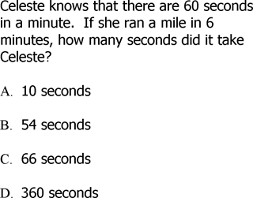
NBT 3

Slide 28
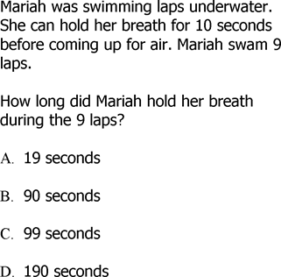
NBT 3

Slide 29
NBT 3

Slide 30
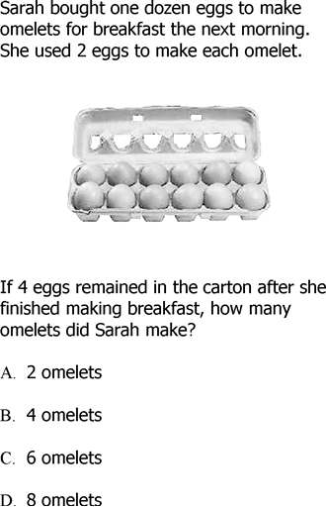
OA.8

Slide 31
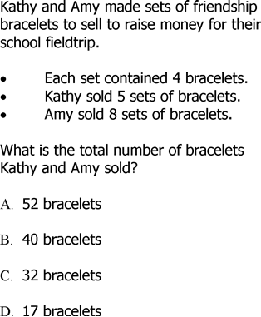
OA.8

Slide 32
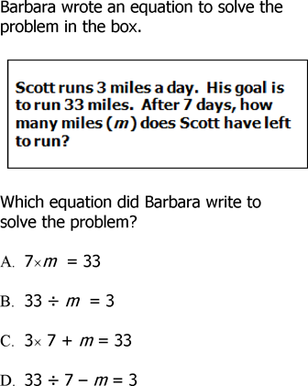
OA.8

Slide 33
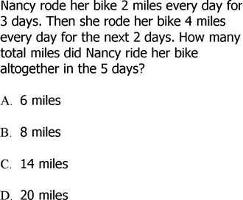
OA.8

Slide 34
OA.8
What number goes in the gray rectangle to make the statement true?
A. | 3087
B. | 3088
C. | 3098
D. | 3099

Slide 35
Allison had 100 books on her shelf. She wanted to get rid of at least half, so that she could buy new ones. Which two operations are mentioned in this problem?
A. | addition and multiplication
B. | subtraction and division
C. | addition and division
D. | subtraction and multiplication
OA.8

Slide 36
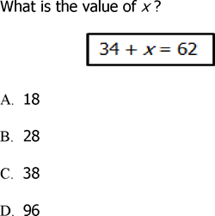
OA.8

Slide 37
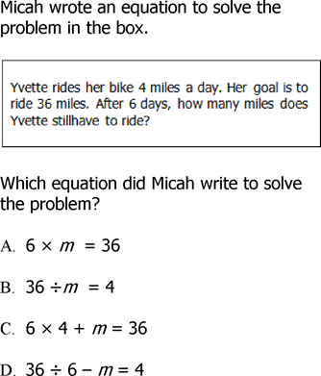
OA.8

Slide 38
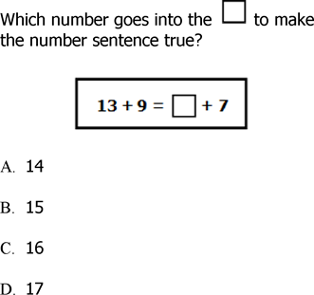
OA.8

Slide 39
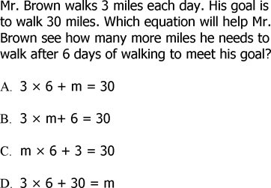
OA.8

